Slide 1
How to Reach and Serve the Olmstead Population? Part 1
MHC Annual Housing Conference
Tax Credits/Federal Grants Division
Beau Rivage, Biloxi MS
March 30, 2022

Slide 2
Panelist
Willie Mae Berry
Case Manager Supervisor
Dr. Tammy Shaffer
Program Administrator
Brandon Morey
AVP of Tax Credits

Slide 3
House Bill 1563
Passed in 2015
Funds were appropriated to target:
Individuals with Disabilities (Mental)
OR
Individuals with Serious Mental Illnesses

Slide 4
House Bill 1563, Section 4 (1)
Must meet one (1) of three (3) criteria:
Criteria 1
Individual is being discharged from:
*State psychiatric hospital, or
Nursing facility, or
*Intermediate Care Facility (for individuals with intellectual disabilities)
*Individual had to have stayed more than 90 days

Slide 5
House Bill 1563, Section 4 (1)
Must meet one (1) of three (3) criteria:
Criteria 2
Individual has been discharged from a State Psychiatric Hospital within the last two (2) years AND:
Had multiple hospital visits in the last year due to mental illness; or
Are known to the mental health or state housing agency to have been arrested or incarcerated in the last year due to conduct related to mental illness; or
Are known to the mental health or state housing agency to have been homeless for one full year or have had four (4) or more episodes of homelessness in the last three (3) years.

Slide 6
House Bill 1563, Section 4 (1)
Must meet one (1) of three (3) criteria:
Criteria 3
Individual lacks a fixed, regular, and adequate nighttime residence and includes a subset for an individual who is exiting an institution where he/she resided for 90 days or less and who resides in an emergency shelter or a place not meant for human habitation immediately before entering that institution.

Slide 7
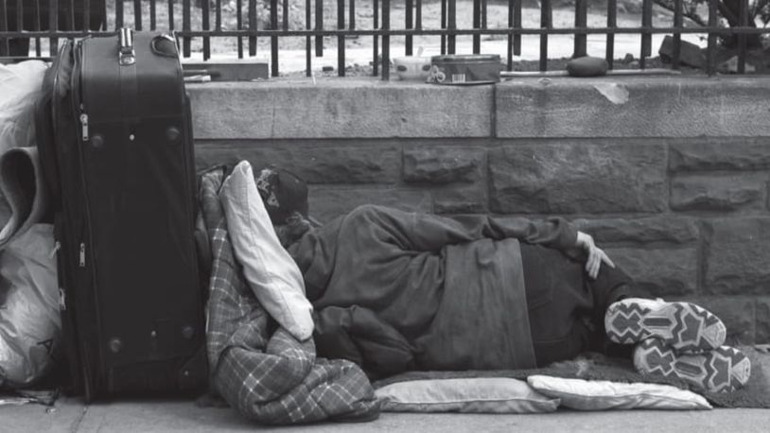
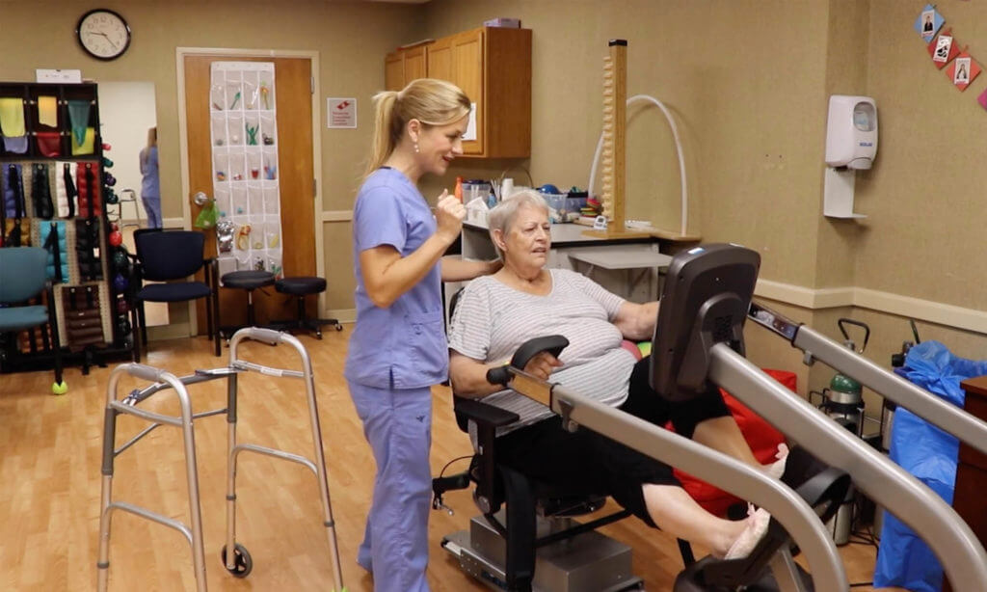
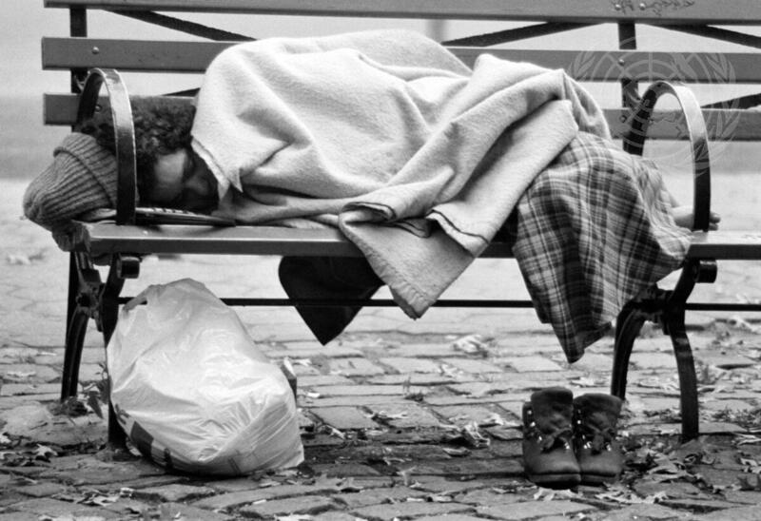
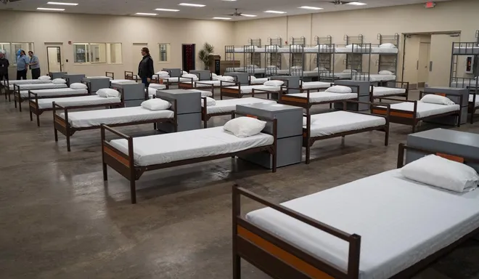
House Bill 1563, Section 4 (1)
Mentally Disabled
Serious Mental Illness
Category 1
Category 2
Category 3
90 Days
2 Years

Slide 8
MHC’s Response
Beginning in 2016
M
A
O
I
ississippi
ffirmative
lmstead
nitiative
Creating Housing Options In Communities for Everyone

Slide 9
MAOI
Since 2016
Responsibility of Property Managers/Owners
MAOI has been added to the Qualified Allocation Plan
1. Agree to accept referrals from MAOI referral network partner
2. Execute a MOU between the owner, manager, and referral network partner
3. Ensure tenant selection plan does not unintentionally disqualify MAOI clients
4. Demonstrate continuous marketing efforts
5. Apply Next Available Unit concept

Slide 10
MHC’s Response
Since 2016
335 Units
Have been set aside from 2016 through 2021 to house MAOI residents
Bonus Points removed

Slide 12
Challenges
Willie Mae Berry
Case Manager Supervisor

